Slide 1


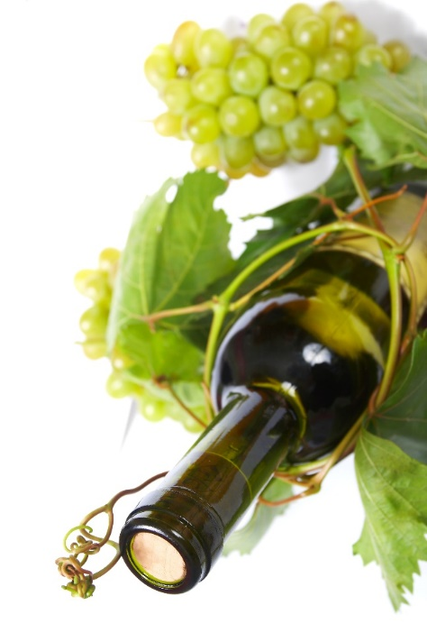

Modernizing Agricultural Practice using Internet of Things
MAPIoT Summer School in Norway
24.07.2022 – 07.08.2022
Melsom High School, Sandefjord organized by University of South-Eastern Norway
Using AI in fermentation process
– theory and applications
Professor Anca Şipoş, PhD
“Lucian Blaga” University of Sibiu
^{anca.sipos@ulbsibiu.ro}
¹) The digital materials do not reflect the views of Financial Mechanism Office (FMO), and they do not purport to be representative of the countries, regions and themes they illustrate. The use of the materials does not imply endorsement by the FMO, the Donor States, the Beneficiary States, or any other stakeholder of the EEA and Norway Grants. The FMO is not liable for any law infringements by third parties in the context of the operation and use of the media library.

Slide 2

Overview
Noun [Uncountable]:
the mixing of the ideas, customs, etc. of different places or groups of people, to produce a better result
Technological process in winemaking
Fermentation process
Process modelling
Process temperature automatic control
Knowledge-based system as a software application for the supervision and intelligent control of the process
Using AI in fermentation process

Slide 3

The technological process in winemaking
The technology of obtaining wine involves the transformation of raw grapes into wine.
The manufacturing technology of different types of wine, white, rosé, red is different for each assortment and is influenced by the characteristics of the raw materials, by the facilities of the winery, respectively technological spaces, equipment and country-specific legislation requirements.

Slide 4
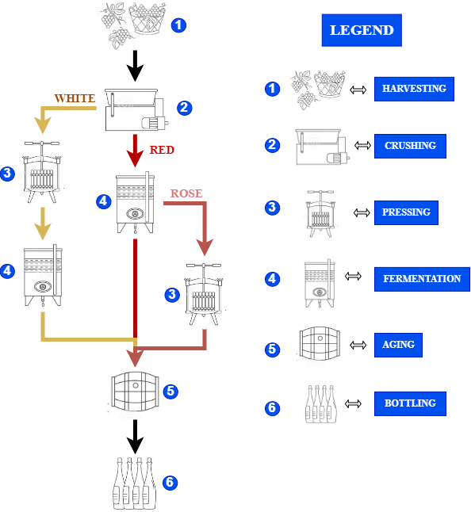
The technological process in winemaking
The general technological flow of wine involves two different winemaking processes white winemaking and red winemaking.
After harvesting process is finished (step 1 – figure 1), the grapes are crushed for grape must release (stage 2 - figure 1). The resulting grape must, in the case of white winemaking, is subjected immediately to the operation of separating the must from the solid parts, by pressing; the must obtained is pumped into fermentation vessels (stage 4 - figure 1).
For red wines, the must has to remain in contact with the solid parts to facilitate the extraction process of the compounds of interest, respectively color, taste and flavor compounds. If you want to get rosé wines, it is necessary to separate the must after a few hours of maceration.
Figure 1. The technological flow of wine: white, rose and red wines

Slide 5
The technological process in winemaking
The general technological flow of wine involves two different winemaking processes white winemaking and red winemaking.
After completing fermentation operation, the red wine is separated from the fermented wine by free draining and pressing.
The wines obtained are matured in order to define the physio-chemical, biological and sensory characteristics (stage 5 - figure 1).
Finally, when the product corresponds to the type of wine, it is bottled (step 6 – figure 1).
The fermentation process
Figure 1. The technological flow of wine: white, rose and red wines

Slide 6
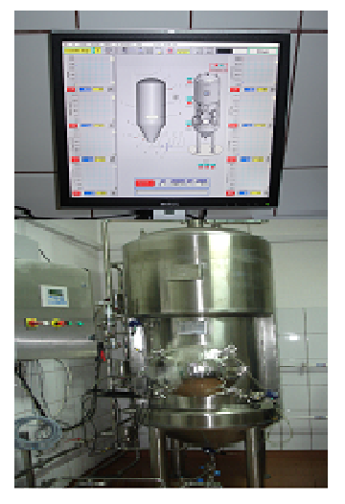
The technological process in winemaking
The fermentation process
Wines are alcoholic beverages obtained by the exclusive fermentation of grape must, respectively, with the fermentation yeast.
Compared with other foods that are part of the daily diet and are responsible for the nutritional intake necessary for the good functioning of the human body, wine is consumed as food diversity.
The literature review and experimental observations have led to the conclusion that:
    the first step in the fermentation is the catalyst synthesis, namely the growth of yeast with the nitrogen amount as limiting substrate;
    the second one is the catalysis, namely the degradation of the non-limiting sugar substrate into ethanol and carbon dioxide.

Slide 7
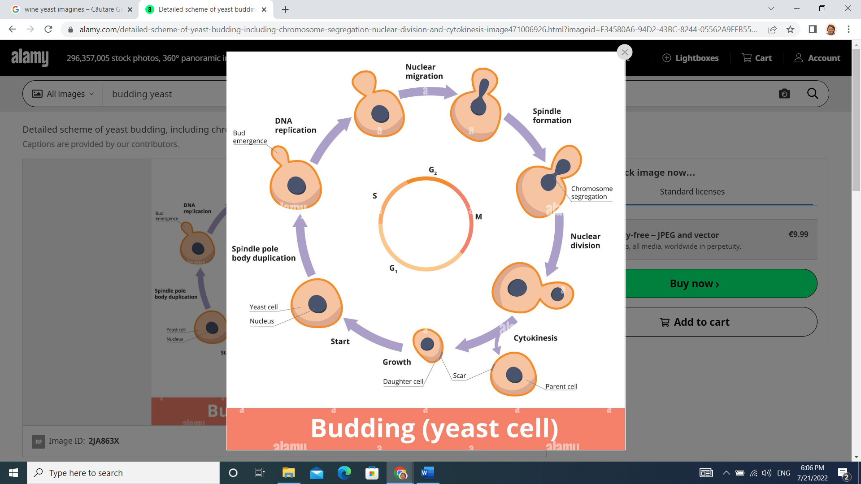
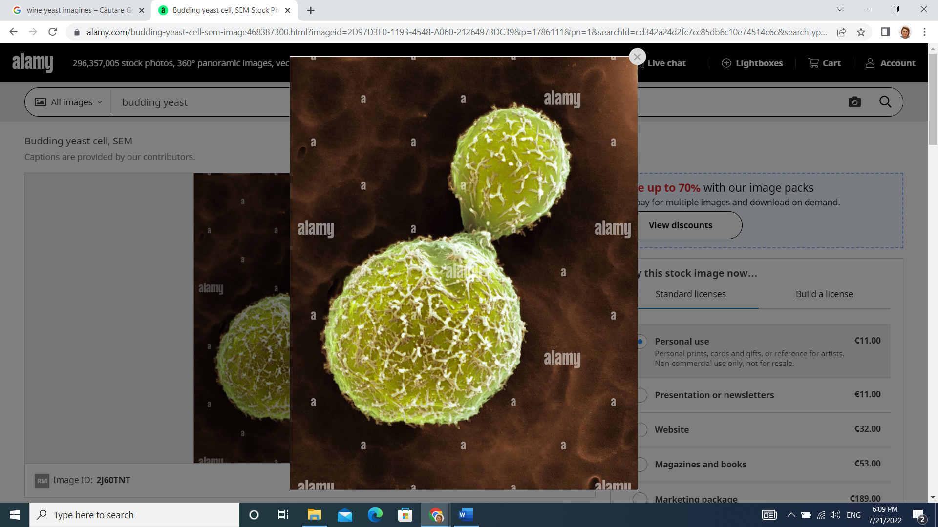
The technological process in winemaking
The fermentation process
Microbiological aspects for fermentation of wine
Yeast is the most important microorganism that produces the alcoholic fermentation of wine.
The growth and multiplication of these microorganisms under industrial conditions involves activating the metabolic processes leading to the formation of ethanol, carbon dioxide and numerous secondary metabolites that contribute to the taste and aroma of wine (Swiegers and Pretorius, 2005; Cordente et al., 2012; Takoi et al., 2010).
In winemaking conditions, a part of nitrogen is assimilated so as to synthesize new yeast cells but the remaining part is mostly used in the synthesis and repairing of essential proteins, see figure 2. Indeed, the yeast cell can assimilate glucose and nitrogen thanks to dedicated proteins called transporters which allow the membrane crossing.

Slide 8
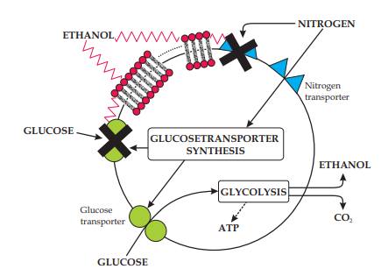
The technological process in winemaking
The fermentation process
Microbiological aspects for fermentation of wine
During the fermentation, these transporters proteins have to sustain a catabolic inactivation by the ethanol. This phenomenon increases with the ethanol concentration and impacts the sugar transport, hence the fermentation kinetic is slacked (decrease of CO₂ production rate). Experiments have shown that when the initial nitrogen concentration is low, the yeast mainly focus on the cells production. When N₀ (initial concentration in nitrogen) is larger, the cells production increases but at the same time more nitrogen is used for the transporters synthesis so as to prevent their catabolic inactivation (Malherbe, 2003).
Figure 2. Yeast activity scheme (Malherbe, 2003)

Slide 9
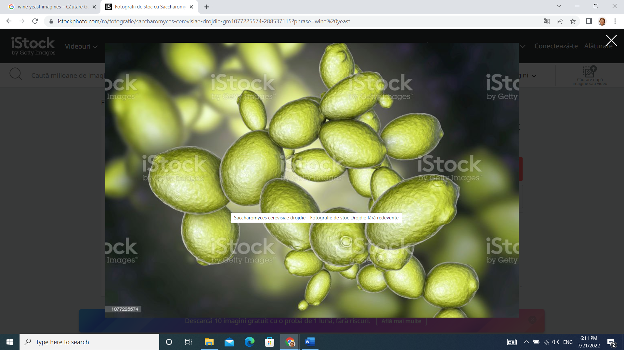
The technological process in winemaking
The fermentation process
Microbiological aspects for fermentation of wine
The yeasts involved in wine technology have different sources of origin from the raw material, namely present on the grapes, the microflora of the vinification center, the technological equipment or the starter cultures used in different technologies.
Yeast is of particular importance in wine technology, ensures the conversion of sugars into ethyl alcohol and carbon dioxide and contributes to the formation of flavor and taste compounds, resulting as secondary metabolites during growth and multiplication phases, or cell autolysis. Thus, along with the primary flavor compounds determined by the grape variety used, flavor compounds resulting from fermentation processes determine the finished product wine bouquet. Under certain conditions, on the technological flow of wine, yeasts can act as microorganisms of contamination, being involved in the appearance of wine diseases.

Slide 10
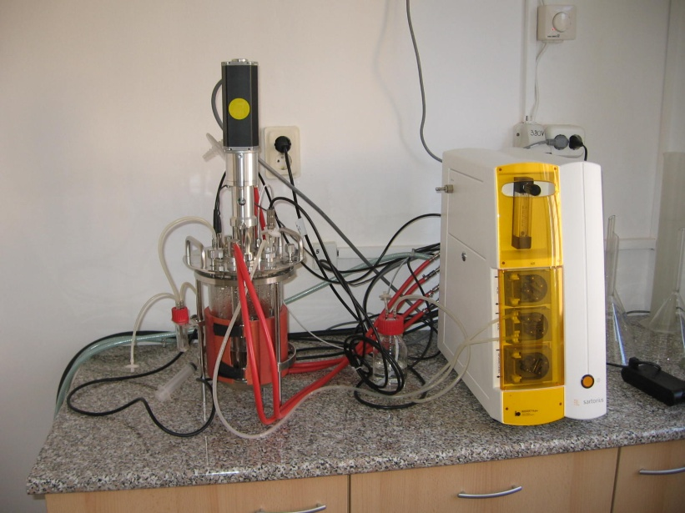
The technological process in winemaking
The fermentation process
Microbiological aspects for fermentation of wine
Yeast can be classified into two groups: the Saccharomyces group and the non-Saccharomyces group (Sadoudi et al., 2012; Medina et al., 2012). The yeasts of the Saccharomyces group are found to be small on the grapes and on the facilities in the wine-making centre. The main species of this genus are: S. acidifaciens, S. chevalieri, S. heterogenicus, S. oviformis, S. elipsoideus. The yeasts of the non - Saccharomyces group are found to be larger count on the grapes peel, so they are associated with the origin and quality of the raw material, and less to the vinification centre.
Modern winemaking technologies use selected strains of Saccharomyces (S. cerevisiae) and non-Saccharomyces (Torulospora delbrueckii, Pichia kluyverii, Kluyveromyces thermotolerans) to diversify wine varieties (Vandamo et al., 2008).
Selected fermentation yeast allows the control of alcoholic fermentation by rapid fermentation start and inhibition of wild yeast action, increasing the use of sugars and achieving a predictable alcohol yield, increased bottling alcohol content to 15% vol., increased resistance to -sulfur dioxide, low production of secondary metabolites of sulfur compunds, pyruvic acid, acetic acid and acetaldehyde, reduced foaming, high-capacity flocculation.

Slide 11
The biotechnological processes modelling
A biotechnological process implies a development (growth) of a microorganism population (culture medium), biomass, in a bioreactor (vessel) by the consumption of some nutrients (carbon, nitrogen, oxygen, vitamins etc.) that represent the substrate, if the physical and chemical conditions (temperature, pH, aeration etc.) are favourable.
Customarily, the microorganisms' growing takes place in a liquid medium (aqua).
It is obvious that in a bioreactor a lot of biochemical and biological reactions take place simultaneously. Each elementary reaction is, usually, catalysed by a protein (enzyme) and can form a specific product or metabolite.
Because the microbial mechanism of growth that involves alive organisms is very complex, a detailed modelling is not possible or is very complicate.
Usually, the bioreactor assumes a perfect stirred and is describe by several macro scope variables, such as: biomass, substrate, product, oxygen concentrations, pH, temperature etc.

Slide 12
The biotechnological processes modelling
The mathematical model of a bioreactor depends on its operating mode. In this way, in practice, for these types of bioreactors three operating modes could be defined:
Batch mode - A batch bioreactor is a reactor with a cyclical operating, without feed and exit flows. The entire quantity of substrate and nutrients, with a small quantity of biomass are introduced in the bioreactor at the beginning of the fermentation. During the fermentation, the bioreactor will be not fed with any substrate and the process will be completed after the substrate has been sufficiently consumed. The result is that the entire quantity of biomass is collected, from which then the desire product will be extracted. The possibilities of process control in this case are very limited and could be resumed with some physical variables: temperature, pH, energetically consumption, length of fermentation etc.

Slide 13
The biotechnological processes modelling
The mathematical model of a bioreactor depends on its operating mode. In this way, in practice, for these types of bioreactors three operating modes could be defined:
Fed-batch mode - The fed-batch bioreactors type or with semi continuous operating are reactors with cyclical working, with a continuous or intermittently feeding and without exit. In the vessel is initially introduced both a small quantity of substrate and a biomass. Then, during the fermentation process, and in function of the microorganisms’ necessities, the reactor will be fed with a controlled flow of substrate. Therefore, the possibilities of process control of this kind of bioreactors are more diverse than that of the batch type. Aside from the physical variables, the biological variables: substrate concentration, biomass concentration etc. can also be controlled.

Slide 14
The biotechnological processes modelling
The mathematical model of a bioreactor depends on its operating mode. In this way, in practice, for these types of bioreactors three operating modes could be defined:
Continuous mode - This mode is more efficiently from the economical point of view and the bioreactors are with stirred, with continuous operating, eventually with separation and recycling, as well the gas-liquid bioreactors, used especially in the industry for obtaining a great volume of biomass (i.e. unicellular proteins) or for the biological treatment of residual water. In such a reactor, the biomass is evacuated with a flow equal with that of the substrate feeding.

Slide 15
The biotechnological processes modelling
The mathematical model of a biotechnological process is formed by an equation system in which the components or the concentrations of components implied in reactions that take place in bioreactor appear, equations which are obtained by writing, for each component, the mass and energetic balances.
The dynamic or variation in time of the quantity of each component is expressed by two phenomena:
  Primarily, there are chemical, biochemical, and biological reactions which transform certain components in others.
  Secondarily, mass transfer due to the liquid and gas interchanges between the reactor and the environment or with other bioreactors exists.
Within this context, the mathematical model of a bioprocess represents a mathematical description of two types of phenomena, where the chemical, biochemical and biological reactions cause the bioprocess kinetics while the mass transfer phenomena defines the dynamics of transport.

Slide 16
The biotechnological processes modelling
The kinetic of microorganisms growing
Specific rate of growing, [h⁻¹]
0.4
0.0
The kinetic of microorganisms' growing (figure 3) is necessary from the point of view of knowing the process phases (table 1), the duration of these phases, the factors which influence them in order to choose then the type of vessel and the process control mode for the bioreactor.
1.0
I
II
III
IV
V
VI
VII
Optical density, [AU]
0.8
0.6
0.4
0
2
4
6
8
24
26
28
Time, [h]
Figure 3. The microorganisms number evolution vs. time

Slide 17
Table 1.
The microbial population growing phases

Slide 18
The biotechnological processes modelling
The kinetic of microorganisms growing
The types of kinetic models
The phenomena which take place in a bioreactor are complex and coupled.
The complexity is given by the heterogenic medium three-phases (solid, liquid and gas), in which the biosynthesis process take place; the three-phases medium is in a dynamic evolution and has a nonlinear character.
The processes are coupled among them, an operational variable (the feed flow with substrate, the pressure, the temperature, the stirred etc.) or the way in which the oxygen reaches at the microorganisms, are important both individually and for the whole microorganisms, for the biomass process control (Bastin et Dochain, 1990).

Slide 19
The biotechnological processes modelling
The kinetic of microorganisms growing
The types of kinetic models
In figure 4, the main phenomena are presented, the interactions and variables which influence the kinetic behaviour of the population cells.
Figure 4. The main phenomena, interactions and variables which influence the kinetic of the microbial populations

Slide 20
The biotechnological processes modelling
The kinetic of microorganisms growing
The types of kinetic models
A complex model of a bioreactor:
is multi-phases;
it consists of a medium with solid particles among which liquid and gas particles (at the surface being the microbial culture) are dispersed or from a liquid medium in which gas bulls are dispersed. An example of three-phases model, with two physical phases, gassy and liquid phases and a biotical one - the microorganisms’ culture, is presented in figure 5, model which could be considered a model of a fermentation process (alcoholic fermentation process in winemaking).
Figure 5. A bioreactor model with three structured phases

Slide 21
In table 2 the most used mathematical models in biotechnological processes simulation, models used in process and optimal control of fermentative industrial processes are presented.
Tabel 2. The empirical models most used in fermentation industrial processes simulation

Slide 22
In table 2 the most used mathematical models in biotechnological processes simulation, models used in process and optimal control of fermentative industrial processes are presented.
Tabel 2. The empirical models most used in fermentation industrial processes simulation

Slide 23
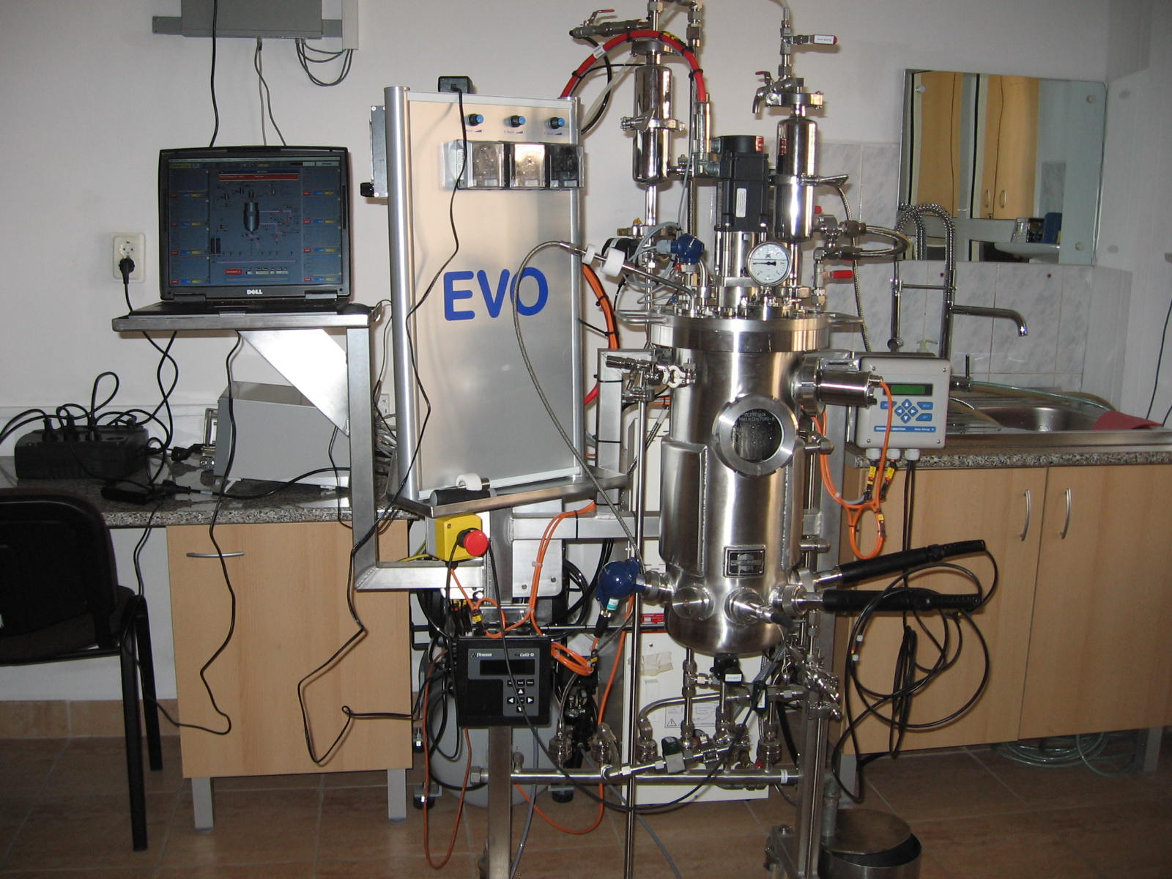
The biotechnological processes modelling
Study case - modelling of a white wine alcoholic fermentation process
The models developed for these cases consequently have various domains of applications but none of them include the whole oenological aspects of the process. The majority of the models are of “knowledge-based” models type and they take into consideration a great number of phenomena that have an important effect on the kinetics of the process fermentation (Svendsen et al., 2015).
Experimental conditions
To evaluate the total fermentation yield losses under different operating conditions, four experiments were carried out and based on the data obtained within these experiments, a mathematical model was proposed. The strain and the culture medium, the equipment and the experimental conditions together with the measurements of the fermentation parameters were presented by Sipos and co-workers (Șipoș et Imre-Lucaci, 2014; Șipoș et Agachi, 2015). For the experiments the Saccharomyces cerevisiae YEPD wine yeast was used, being seeded on a culture medium with the following composition: 5 g/L KH₂PO₄, 2 g/L (NH₄)₂SO₄, 0.4 g/L (MgSO₄).7H₂O, 1 g/L yeast extract, 50 g/L glucose and Mauzac must (sterilized through flash pasteurization). The sugar content of the grape must was supplemented with sucrose up to 180 g/L and 40 mL/h tiaminol were added. The SO₂ content reached 50 mg/L and the pH was adjusted at 3.8 mg/L H₃PO₄. Both the fermentation medium and the bioreactor were autoclaved for 20 minutes at 393 K. A New-Brunswick continuously stirred bioreactor equipped with pH and temperature sensors was used.

Slide 24
The biotechnological processes modelling
Study case - modelling of a white wine alcoholic fermentation process
Experimental conditions
The following operating conditions were: working volume – 8 L; temperature – 291 K and 301 K; stirring speed – 150 rpm; pH – 3.8; influent glucose concentrations – 180 g/L and 210 g/L; without aeration, the necessary oxygen was dissolved in must.
The mathematical model
The mathematical model of the alcoholic fermentation process was determined on the basis of the approach of the zone modelling principle, taking into consideration the evolution of the viable biomass (X_{v}(t)). Based on the analysis of the phenomenological aspects of the alcoholic fermentation process, the evolution of X_{v}(t) was divided in three parts (figure 6) as follows:
- latent phase (1);
- growing phase (2);
- decay phase (3).
125
Yeast population, [millions/mL]
100
X_{v}(t)
75
50
25
1
2
3
2
4
6
8
10
12
14
16
Time, [days]
Figure 6. Evolution of the viable biomass concentration X_{v}(t)

Slide 25
The biotechnological processes modelling
Study case - modelling of a white wine alcoholic fermentation process
Table 3 presents the equations of the model. The parameters are adjusted through the non-linear programming method, which compares the model predictions with experimental data and minimises the errors.
Table 3.The model of the alcoholic fermentation process

Slide 26
The biotechnological processes modelling
Study case - modelling of a white wine alcoholic fermentation process
Table 3 presents the equations of the model. The parameters are adjusted through the non-linear programming method, which compares the model predictions with experimental data and minimises the errors.
Table 3.The model of the alcoholic fermentation process

Slide 27
Study case - modelling of a white wine alcoholic fermentation process
Tables 4 and 5 present the list of the variables and parameters of the mathematical model.
Table 4. Variables and parameters of the kinetic model
^{a, d} (Cerda-Drago et al., 2016; Liu et al., 2016; Scaglia et al., 2014), ^{b} (Bovée et al., 1984), ^{c} (Dengfeng et al., 2014)

Slide 28
The biotechnological processes modelling
Study case - modelling of a white wine alcoholic fermentation process
Table 5. Parameters of the kinetic model
ª (Pérez et al., 2018), ^{b} experimental data, ^{c} (Schenk et al., 2017)

Slide 29
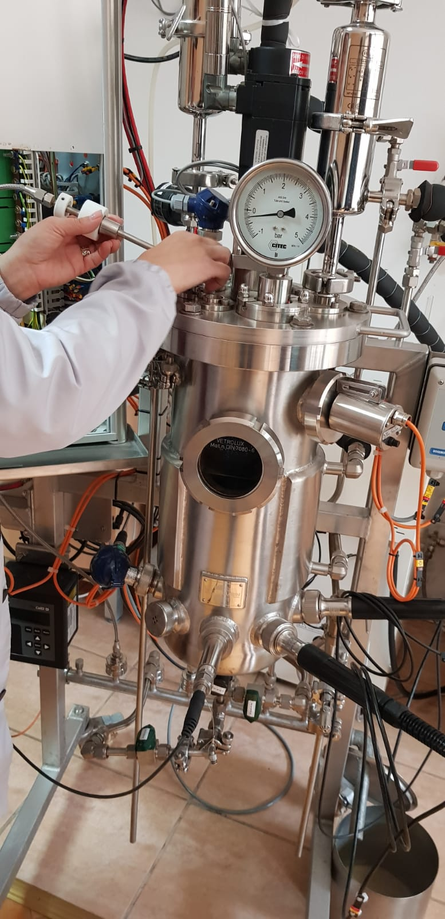
The biotechnological processes modelling
Study case - modelling of a white wine alcoholic fermentation process
Results and discussion regarding the mathematical model simulation
The nonlinear mathematical model of the batch fermentation process (table 3) used in this work contains the following equations:
an equation for the latent phase of fermentation that describes the dependence of the phase time of the process temperature;
the model proposed by Aiba (Caraman et al., 2002) for the growing phase with the three equations of biomass, alcohol production and substrate consumption;
the model presented by Bovée-Strehaiano (Bovée et al., 1984) for the decay phase with two equations: one for the substrate consumption and the other for alcohol formation;
an equation that describes the biomass behaviour along the phase no. 3 (the model proposed by Sipos in (Șipoș et Imre-Lucaci, 2014; Șipoș et Agachi, 2015));

Slide 30
The biotechnological processes modelling
Study case - modelling of a white wine alcoholic fermentation process
Results and discussion regarding the mathematical model simulation
The nonlinear mathematical model of the batch fermentation process (table 3) used in this work contains the following equations:
an equation that describes the carbon-dioxide concentration behaviour along the all phases (the model proposed by Sipos);
an energy-balance model in which the rate of change of the medium’s temperature (dT⁰/dt) is a result of the balance between the rate of the heat generation due to fermentation and the rate of the heat transfer to the cooling medium inside the bioreactor jacket.

Slide 31
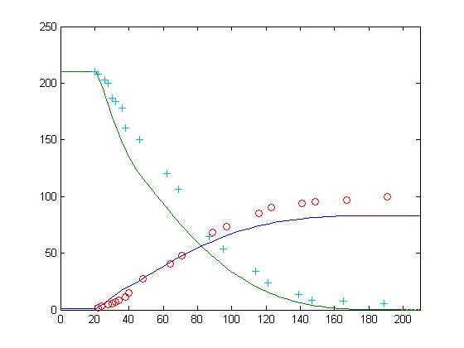
The biotechnological processes modelling
Study case - modelling of a white wine alcoholic fermentation process
Results and discussion regarding the mathematical model simulation
Figures 7, 8 and 9 show the simulation results of the model presented in table 3 considering the following initial values: the initial substrate concentration was 210 g/L and the fermentation temperature was 301 K.
Glucose concentration, S [g·L⁻¹];
Alcohol concentration, P [g·L⁻¹] ;
S
Figure 7. Evolution of glucose and alcohol concentrations; a comparison between experimental values (o - glucose and + - alcohol) and simulation
P
Time, [h]

Slide 32
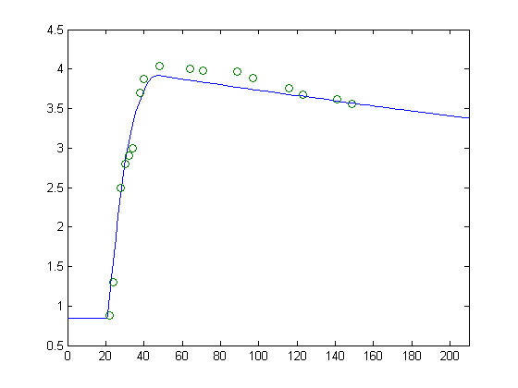
The biotechnological processes modelling
Study case - modelling of a white wine alcoholic fermentation process
Results and discussion regarding the mathematical model simulation
Biomass concentration, X [g·L⁻¹]
Figure 8. Comparison between the biomass simulation results (continuous line) and experimental data (o)
Time, [h]

Slide 33
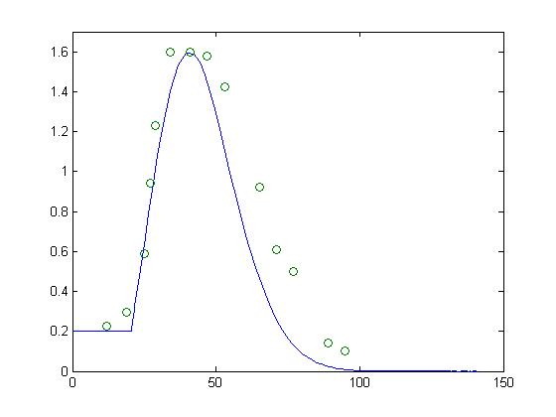
The biotechnological processes modelling
Study case - modelling of a white wine alcoholic fermentation process
Results and discussion regarding the mathematical model simulation
Carbon-dioxid concentration, [g·L⁻¹]
Figure 9. Comparison between the carbon-dioxide concentration simulation results (continuous line) and experimental data (o)
The equation of the latent phase is valid for a time interval [0, 100 h] and the model has been tested for a grape juice variety with an initial concentration of the substrate varying between 180 and 210 g/L, a fermentation temperature between 299 and 303 K and without aeration.
Exemplification in MATLAB
Time,[h]

Slide 34
Objectives
The alcoholic fermentation process temperature automatic control
To find a performing solution for the temperature automatic control of the alcoholic fermentation process because in the biomass growing phase, the temperature' value represents an important factor of the finite product quality.
To get detailed information regarding the dynamics of the process variables (about those that have a strong influence on the fermentation process), using direct measurements.

Slide 35
Temperature automatic control of the biomass exponential growing phase
The alcoholic fermentation process temperature automatic control
The temperature automatic control is based on the following two aspects:
1. Due to the limitations of saturation on the flow of cooling agent, F_{ag}, a very strong non-linearity influence is in the system.
2. The effect of the variations develop in the biomass exponential growing phase as caused by the initial value modification of the state variables (biomass concentration, X, substrate concentration, S and fermentation process's temperature, T⁰). The biomass specific growing rate value (bigger or smaller) is observable by the process while the quantity of heat liberates during the process. Thus, this phenomenon will influence the kinetics dynamic of the fermentation process.

Slide 36
Temperature automatic control of the biomass exponential growing phase
The alcoholic fermentation process temperature automatic control
x_{o}
-
biomass:
-
a
lcohol:
F_{ag}
-
substrate:
Tº
-
carbon
-
dioxide concentration
:
-
energy balance:
Figure 10. The structure and the model of the process used in the temperature automatic control

Slide 37
The alcoholic fermentation process temperature automatic control
The first adopted automatic control used a PI controller, for which the parameters help to avoid the saturation of the control valve that adjusts the feeder flow with cooling agent.
Cooling agent flow,[m³/h]
Temperature,[K]
Time,[h]
Time,[h]
Figure 11. The evolution of the fermentation process' temperature (T⁰), of the reference' temperature (T_{p}⁰) and of the cooling agent' temperature in the jacket (T⁰_{ag})
Figure 12. The cooling agent flow evolution

Slide 38
The alcoholic fermentation process temperature automatic control
To investigate the properties of the loop control system were applied at t = 30 hours a step on the reference value to reduce this value and at t = 40 hours another step to increase this value.
Figure 13. The fermentation process' temperature and cooling agent temperature evolutions
Figure 14. The cooling agent flow evolution

Slide 39
The alcoholic fermentation process temperature automatic control
To obtain better results was studied a second solution of temperature automatic control that comprised the logic' fuzzy and had as aim to obtain good properties of ruggedness of fuzzy command, at the dynamic properties change and in the conditions of some non-linearity such is the control valve saturation.
Figure 15. The reference and temperature of the reaction medium evolution
Figure 16. The cooling agent flow evolution

Slide 40
The alcoholic fermentation process temperature automatic control
Conclusion
The results obtained with fuzzy controller are similar with those obtained with PI controller and this aspect confirms the findings presented at the previously solution, regarding the asymmetry of system operating at the variation sense imposed to the reference.
Exemplification in MATLAB

Slide 41
Objectives
A knowledge-based system as a sustainable software application for the supervision and intelligent control of the alcoholic fermentation process
Finding the solution’s phase determination of the fermentation, at any time of the process.
The automation control of the process, depending on the length of each fermentation phase, to make decisions for improving the final quality of the wine (a more alcoholic wine, dryer, sweeter etc.) and to determine the end of the process.
The diagnosis of the fermentation process.

Slide 42
A Knowledge-based system as a sustainable software application for the supervision and intelligent control of the alcoholic fermentation process
For the development of the application, the supervision, control, and data acquisition software of the bioreactor from the research laboratory equipment were used.
Figure 17. The scheme of the alcoholic fermentation process control system

Slide 43
A Knowledge-based system as a sustainable software application for the supervision and intelligent control of the alcoholic fermentation process
The main sources of knowledge applied in designing the knowledge-based control system were:
- the expert in the domain of the alcoholic fermentation processes;
- the information obtained from the case studies and from the experimental data;
- the specialised literature.
Information on alcoholic fermentation processes obtained from a representative experimental data analysis
As a result of the experience exchange with the experts in winemaking, ten datasets of “representative” experimental data were used for the analysis produced in the bioreactor in the research laboratory. The following findings resulted from the examination of the physical, chemical, and microbiological variables of the initial conditions, as well as of the control conditions:
The investigation of the experimental data was conducted in four distinct control situations, presented in table 6.

Slide 44
A Knowledge-based system as a sustainable software application for the supervision and intelligent control of the alcoholic fermentation process
Table 6.
The four types of fermentations realized at 21 °C.

Slide 45
A Knowledge-based system as a sustainable software application for the supervision and intelligent control of the alcoholic fermentation process
Information on alcoholic fermentation processes obtained from a representative experimental data analysis
2. Similar evolutions of the process were obtained under the same control conditions and, thus, of the monitored variables.
3. Clues were identified in the experimental data regarding the process of the variables’ correlations, which are of interest in the process control context. The following can be mentioned:
- the temperature and the heat transfer variations affect the fermentation process quality (the alcohol concentration, flavourings, and by-product concentration) as well as the duration of fermentation
- the CO₂ quantity released during each phase of the fermentation process (especially in the tumultuous phase when the biomass is formed) provides relevant information regarding the evolution of the process’s important variables (the substrate consumption, the biomass growth, the substrate deficiency in nitrogen and vitamins, and the alcohol production).

Slide 46
A Knowledge-based system as a sustainable software application for the supervision and intelligent control of the alcoholic fermentation process
The Automatic Control of the Alcoholic Fermentation Process
The automatic control of white wine’s alcoholic fermentation process was designed as a three-level system.
- Level zero represents the measurement and adjustment loops of the bioreactor, regarding the pressure, the CO₂ and O₂ concentrations, the pH, the pO₂, the temperature, and the level.
- At the first level of control, the three phases of the process are the detected function of the characteristics of the fermentation medium (the initial substrate concentration, the nitrogen content that can be assimilated, the vitamin content, the initial concentration of biomass, and the type of yeasts) and, thus, functions of the phase’s duration. The main variables determined at this level are the CO₂ concentration, the pH, and the optical density, which provides information regarding the total biomass concentration during the process.
- The second level achieves the sequence supervision of the process (the sequence of the operations of a fermentation batch) so that this level creates a continuous process. The second control level ensures the quality of the process, as well as its diagnosis.

Slide 47
A Knowledge-based system as a sustainable software application for the supervision and intelligent control of the alcoholic fermentation process
The Automatic Control of the Alcoholic Fermentation Process
Results and Discussion
Based on the experimental data obtained from the four types of fermentation, the following evolutions were observed: the pH, the optical density (the total concentration of the biomass), and the CO₂ realised concentration as shown in figures 18–22.
Figure 18. The evolution of the pH during the four types of fermentations

Slide 48
A Knowledge-based system as a sustainable software application for the supervision and intelligent control of the alcoholic fermentation process
The Automatic Control of the Alcoholic Fermentation Process
Results and Discussion
Figure 19. The optical density (the total concentration of the biomass) evolutions during the a and b types of fermentation
Figure 20. The optical density (the total concentration of biomass) evolution during types c and d of fermentation

Slide 49
A Knowledge-based system as a sustainable software application for the supervision and intelligent control of the alcoholic fermentation process
The Automatic Control of the Alcoholic Fermentation Process
Results and Discussion
Figure 21. The CO₂ concentration evolution during the a and b types of fermentation
Figure 22. The CO₂ concentration evolutions during the c and d types of fermentations

Slide 50
A Knowledge-based system as a sustainable software application for the supervision and intelligent control of the alcoholic fermentation process
The Automatic Control of the Alcoholic Fermentation Process
Results and Discussion
The results represented in figures 18–22 led to the following conclusions:
- the variation of each studied variable (pH, optical density, and the CO₂ realised concentration), in all of the achieved fermentation cases, offers the possibility to determine the end and the start of the three phases of a fermentation process;
- the end and the beginning of the phases of the fermentation process are detectable based on rules that address the three variables monitored for each fermentation type and, therefore, the length of each phase;
- by monitoring at least two of the three variables, the automatic control solution of the fermentation process can be developed.

Slide 51
A Knowledge-based system as a sustainable software application for the supervision and intelligent control of the alcoholic fermentation process
The Automatic Control of the Alcoholic Fermentation Process
Results and Discussion
The Automatic Control of the Alcoholic Fermentation at the First Level
The automatic control at this level must provide the phases detection of the fermentation process and, thus, the length of each phase. Therefore, using the knowledge obtained in the four types of fermentation, the first level is composed of rules that use data from the pH transducer, the CO₂ analyser, and the optical density sensor, as well as the extended estimator (for substrate concentration).
The structure of a rule is:
RULE: rule_number
CF: certain factor
PRIO: priority
IF: premise
THEN: consequence
DESCRIPTION:
where
<premise>::=<logical _expression>
<logical_expression>::=(<variable_identifier> <relational_operator> <value>) AND/OR/NOT … AND/OR/NOT (<variable_identifier> <relational_operator> <value>),
and
<consequence>::=(<variable_identifier>=<value>)AND/OR…AND/OR <variable_identifier>=<value>).

Slide 52
A Knowledge-based system as a sustainable software application for the supervision and intelligent control of the alcoholic fermentation process
The Automatic Control of the Alcoholic Fermentation Process
Results and Discussion
The Automatic Control of the Alcoholic Fermentation at the First Level
The structure of a rule is:
Observations:
- the allowed relational operators are <, >, <=, >=, =, and <>;
- the priority rules for the logical operators AND, OR, and NOT are those from logical algebra.
Depending on the bioreactor equipment, we developed two types of rules for the three-phase identification of the fermentation process in accordance with table 7.

Slide 53
A Knowledge-based system as a sustainable software application for the supervision and intelligent control of the alcoholic fermentation process
The Automatic Control of the Alcoholic Fermentation Process
Results and Discussion
The Automatic Control of the Alcoholic Fermentation at the First Level
Table 7. The automatic control rules at the first level.

Slide 54
A Knowledge-based system as a sustainable software application for the supervision and intelligent control of the alcoholic fermentation process
The Automatic Control of the Alcoholic Fermentation Process
Results and Discussion
The Automatic Control of the Alcoholic Fermentation at the First Level
Table 7. The automatic control rules at the first level.

Slide 55
A Knowledge-based system as a sustainable software application for the supervision and intelligent control of the alcoholic fermentation process
The Automatic Control of the Alcoholic Fermentation Process
Results and Discussion
Implementation of the Software Application on a Fermentation Process Control
The fermentation process is defined following the sequencing rules of operations, as a finite automaton with a state number:
0 state—inactive bioreactor (but operational),
1 state—bioreactor in loading condition,
2 state—bioreactor in sterilisation condition,
3 state—bioreactor in cooling mode, and
4 state—bioreactor in fermentation process.
Moving from one state to another is done either by a control action of the technologist controller and/or under a signal action from a transducer.
A process control application was created, using the supervision, control, and data acquisition software of the bioreactor. This software application contains rules from the second level (the control rules: the operation sequencing of the fermentation process charge) and those from the first level, as shown in table 8.

Slide 56
A Knowledge-based system as a sustainable software application for the supervision and intelligent control of the alcoholic fermentation process
The Automatic Control of the Alcoholic Fermentation Process
Results and Discussion
Implementation of the Software Application on a Fermentation Process Control
Table 8. The rules used in the fermentation process control software application.

Slide 57
A Knowledge-based system as a sustainable software application for the supervision and intelligent control of the alcoholic fermentation process
The Automatic Control of the Alcoholic Fermentation Process
Results and Discussion
Implementation of the Software Application on a Fermentation Process Control
Table 8. The rules used in the fermentation process control software application.

Slide 58
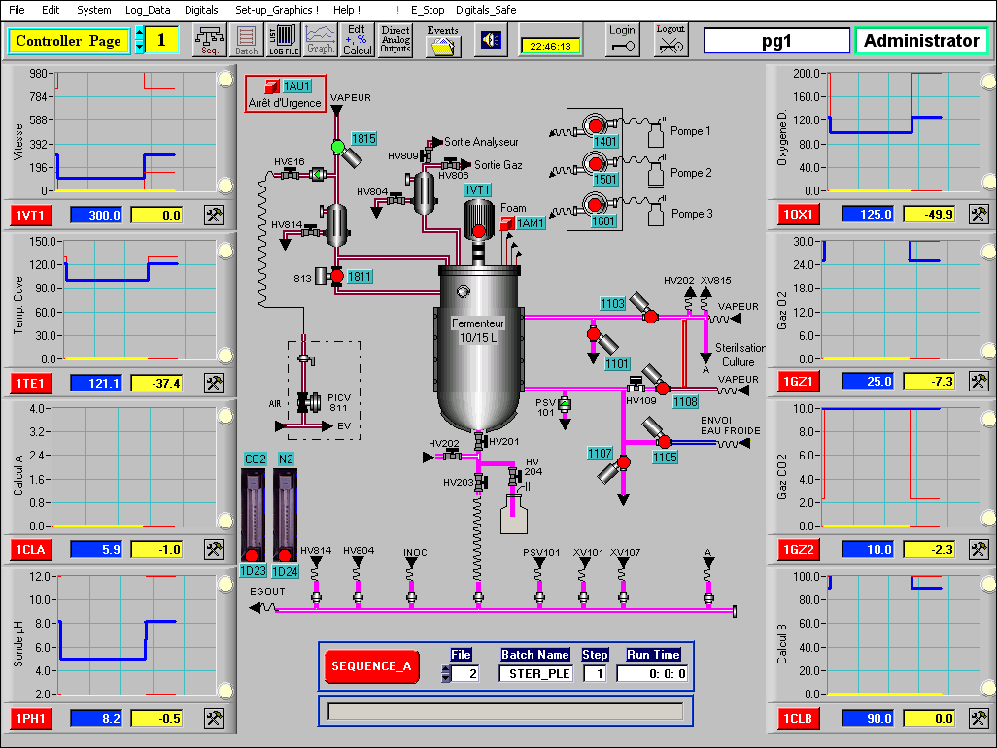
A Knowledge-based system as a sustainable software application for the supervision and intelligent control of the alcoholic fermentation process
The Automatic Control of the Alcoholic Fermentation Process
Results and Discussion
Implementation of the Software Application on a Fermentation Process Control
In figure 23, the technologist controller interface layout is presented. This layout contains switches for triggering or stopping the automation control of different variables, as well as for on-line visualization, in a graphical form. The evolution of the monitored and controlled variables of the fermentation process can be observed. Here, the set-points are inserted, and the control loops of the bioreactor are activated.
Figure 23. The interface layout of the technologist controller.

Slide 59
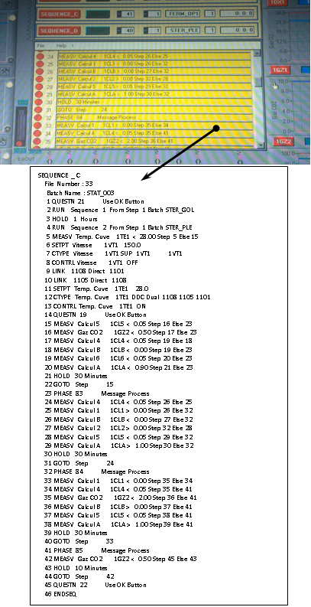
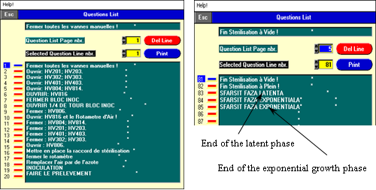
A Knowledge-based system as a sustainable software application for the supervision and intelligent control of the alcoholic fermentation process
The Automatic Control of the Alcoholic Fermentation Process
Results and Discussion
Implementation of the Software Application on a Fermentation Process Control
In the menu bar or tools bar, the wanted sequence of the control process is opened and saved as a file, SEQUENCE_C (Figure 24). Figure 25 contains the question list and the messages sent to the technologist controller. The software list of questions is represented by the control rules.
Figure 24. The set-off window of the sequence process control and the script window.
Figure 25. The windows which contain the question lists formed for the control rules and the messages sent to the technologist controller.

Slide 60
Applying AI Tools for Modelling, Predicting and Managing the White Wine Fermentation Process
The method consists of implementing a pre-trained multi-layer perceptron neural network (NN), using genetic algorithms capable of predicting the concentration of alcohol and the amount of substrate at a certain point in time that starts from the initial configuration of the fermentation process (Florea et al., 2022). The purpose of predicting these process features is to obtain information about status variables so that the process can be automatically driven.
The purpose of predicting these process features is to obtain information about status variables so that the process can be automatically driven.

Slide 61
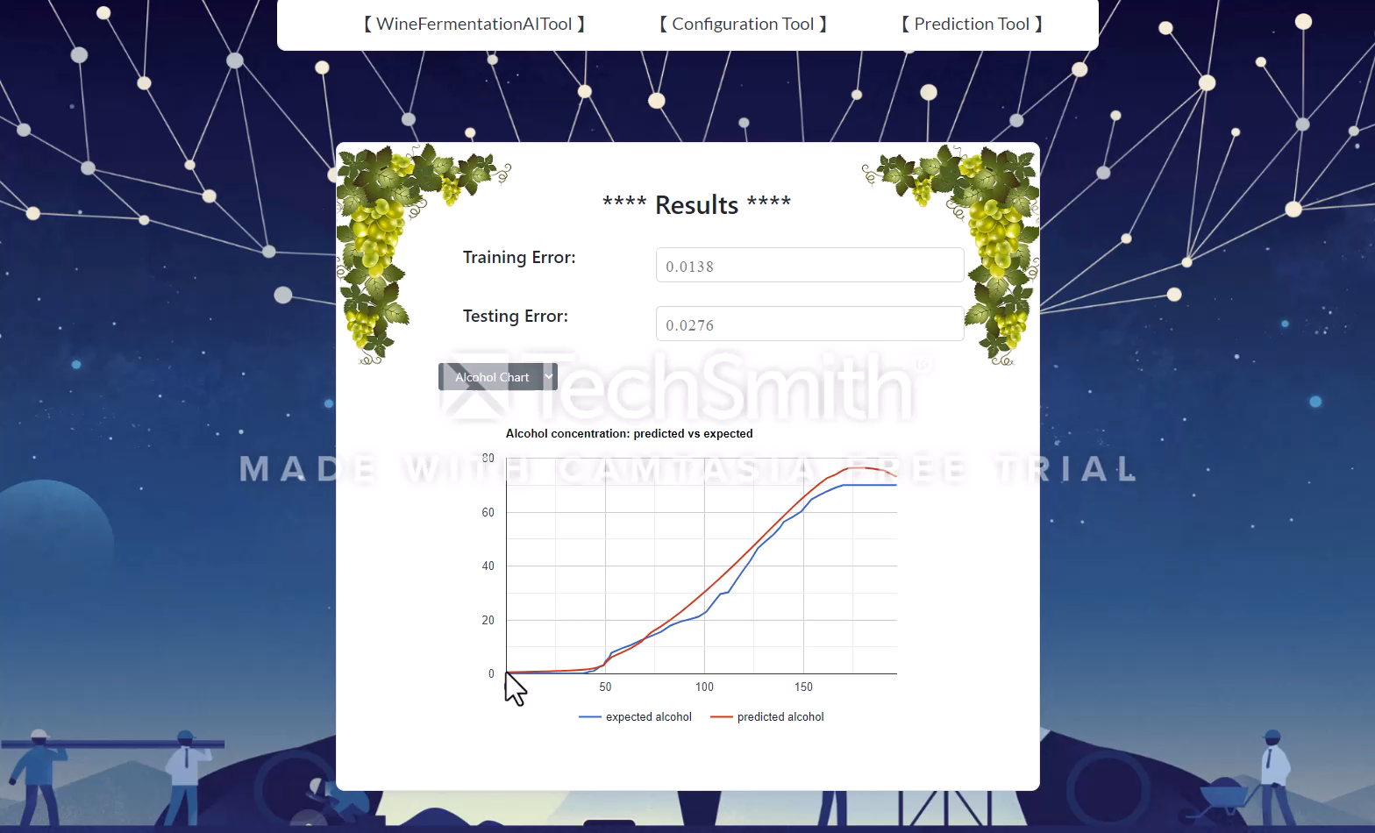
AUTOMATION RULES

Slide 62
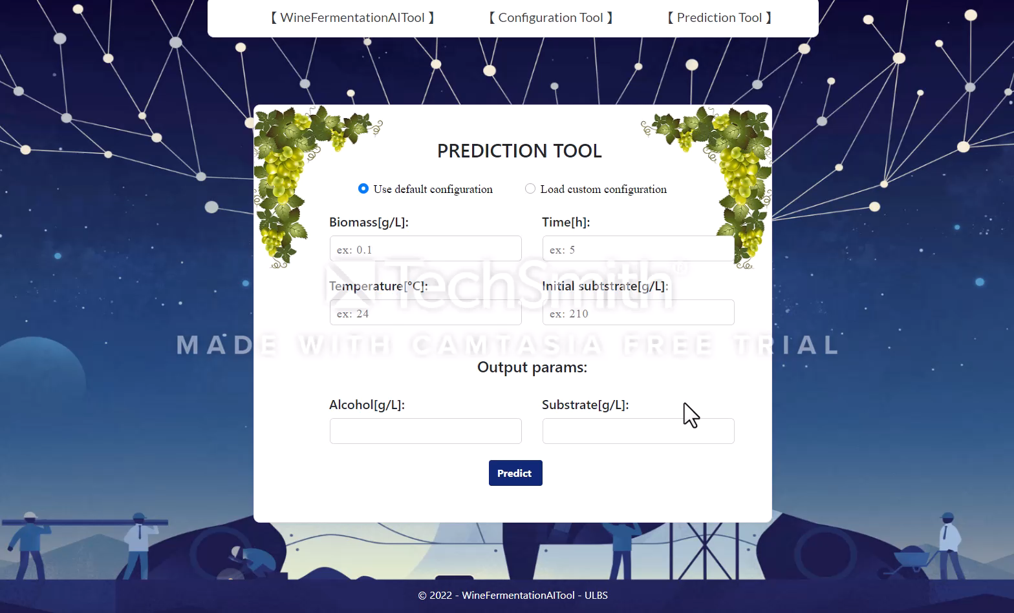
Prediction Tool

Slide 63
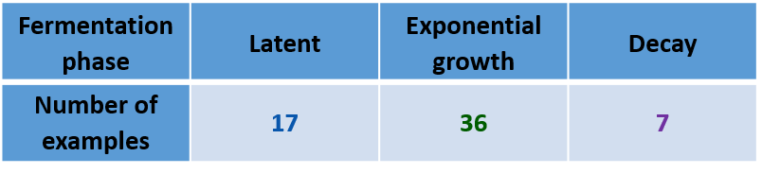
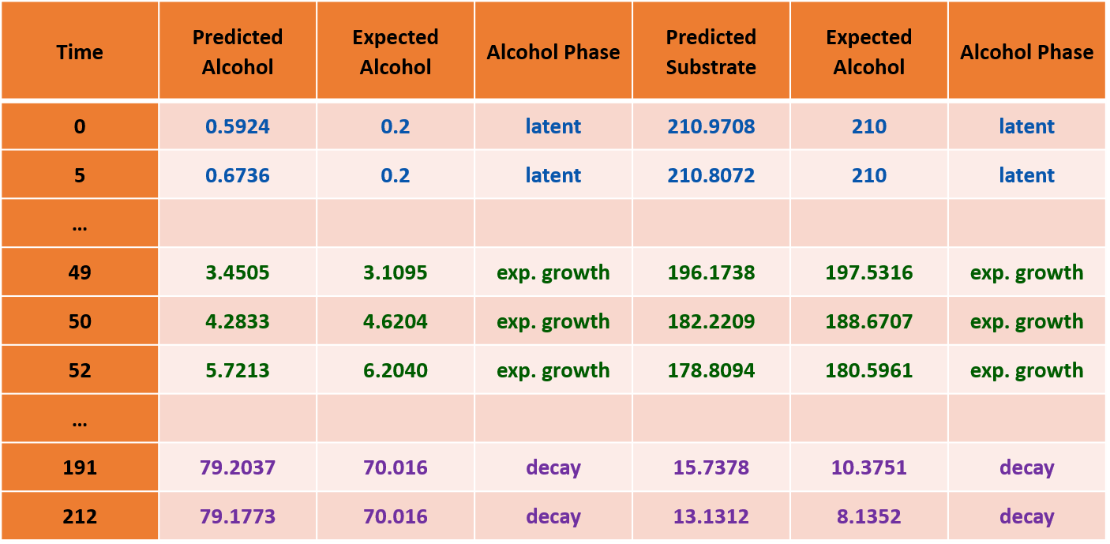
Automation Rules

Slide 64
CONCLUSIONS
Measurements:
Sensor’s system
X, S, P, T⁰
Controller
Control element

Slide 65
CONCLUSIONS
Measurements:
X, S, P, T⁰
Variables estimation:
X, S, P, T⁰
Dynamic model
X, S, P, T⁰
Model outputs
X, S, P, T⁰
Control element
Controller

Slide 66
CONCLUSIONS
Measurements:
X, S, P, T⁰
Variables estimation:
X, S, P, T⁰
NN/Fuzzy model
X, S, P, T⁰
Model outputs
X, S, P, T⁰
Control element
Controller

Slide 67
References
Cordente, A.G., Curtin, C.D., Varela, C., Pretorius, I.S., 2012. Flavour-active wine yeasts. Appl. Microbiol. Biotechnol. 96, 601–618.
Florea A, Sipos A, Stoisor M-C. Applying AI Tools for Modeling, Predicting and Managing the White Wine Fermentation Process. Fermentation. 2022; 8(4):137. https://doi.org/10.3390/fermentation8040137
Malherbe, S. (2003). Mod´elisation de la fermentation alcoolique en conditions oenologiques. Ph.D. thesis, Universit´e de
Montpellier II, France.
Medina, K., Boido, E., Dellacassa, E., Carrau, F., 2012. Growth of non-Saccharomyces yeasts affects nutrient availability for Saccharomyces cerevisiae during wine fermentation. Int. J. Food Microbiol. 157, 245–25.
Sadoudi, M., Tourdot-Maréchal, R., Rousseaux, S., Steyer, D., Gallardo-Chacón, J.J., Ballester, J., Vichi, S., Guérin-Schneider, R., Caixach, J., Alexandre, H., 2012. Yeast–yeast interactions revealed by aromatic profile analysis of Sauvignon Blanc wine fermented by single or co-culture of non-Saccharomyces and Saccharomyces yeasts. Food Microbiol., 32, 243-253.
Sipos A. Current State and Perspective in the Models Applicable to Oenology. In Grapes and Wines - Advances in
Production, Processing, Analysis and Valorization; Jordão, A.M., Cosme, F.; InTechOpen: Rijeka, Croatia, 2018; pp 143-169.
Sipos, A., Florea, A., Arsin, M., Fiore, U. Using Neural Networks to Obtain Indirect Information about the State Variables in
an Alcoholic Fermentation Process. Processes 2021, 9(1), 74. https://doi.org/10.3390/pr9010074
Anca Sipos; A Knowledge-Based System as a Sustainable Software Application for the Supervision and Intelligent Control of an Alcoholic Fermentation Process; Sustainability; vol. 12 (23); pg. 10205-10221; 2020; https://www.mdpi.com/2071-1050/12/23/10205
Swiegers, J.H., Pretorius, I.S., 2005. Yeast modulation of wine flavor. Adv. Appl. Microbiol., 57, 131-175.
Takoi, K., Koie, K., Itoga, Y., Katayama, Y., Shimase, M., Nakayama, Y., Watari, J., 2010. Biotransformation of hop-derived monoterpene alcohols by lager yeast and their contribution to the flavor of hopped beer. J. Agric. Food Chem. 58, 5050–5058.

Slide 68
